Slide 1
EN 204
Material Science for Energy Applications
Class 2
Shaibal K Sarkar
Department of Energy Science and Engineering
shaibal.sarkar@iitb.ac.in

Slide 2
Pre-midSem: TOPICS TO BE DISCUSSED
Electrons in Solids
Bloch's Theorem - Electron waves in Solids
Free Electron Gas - Electrical Conductivity
Energy Band Structure
Nearly-Free Electron Approximation
Books:
Materials Science for Engineers
By Rolf Hummel
Reference:
Elementary Solid State Physics
By Omar
Transport Properties of Solids
Effective Mass Theorem
Boltzmann Transport Equation
Coherent Transport
Semiconductors
Optical Properties of Solids
Dielectric Response
Connection to Transport Properties
Light Emission and Absorption

Slide 3
Pre-midSem: TOPICS TO BE DISCUSSED
Electrons in Solids
Bloch's Theorem - Electron waves in Solids
Free Electron Gas - Electrical Conductivity
Energy Band Structure
Nearly-Free Electron Approximation
Books:
Materials Science for Engineers
By Rolf Hummel
Reference:
Elementary Solid State Physics
By Omar
Transport Properties of Solids
Effective Mass Theorem
Boltzmann Transport Equation
Coherent Transport
Semiconductors
Optical Properties of Solids
Dielectric Response
Connection to Transport Properties
Light Emission and Absorption

Slide 4


Have a quick look at the following cricket stadiums
Dharamsala Cricket stadium
Queensland Cricket stadium
Periodic
Aperiodic

Slide 5
Objective of this section
What is n ?
Understanding J = n.q.v
What is v ?
n = f (density of states, statistical distribution)
Density of states = f (band structure)
Band structure = f(periodic potential)

Slide 6
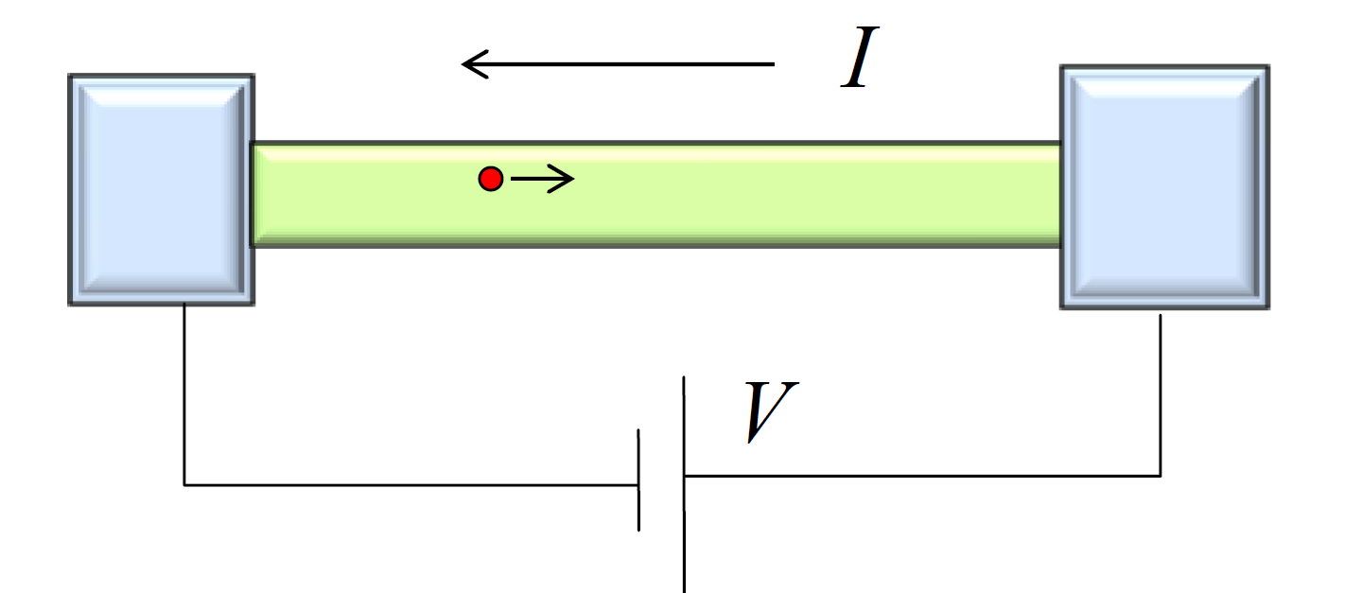
A Fundamental Device

Slide 7
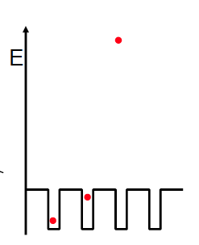
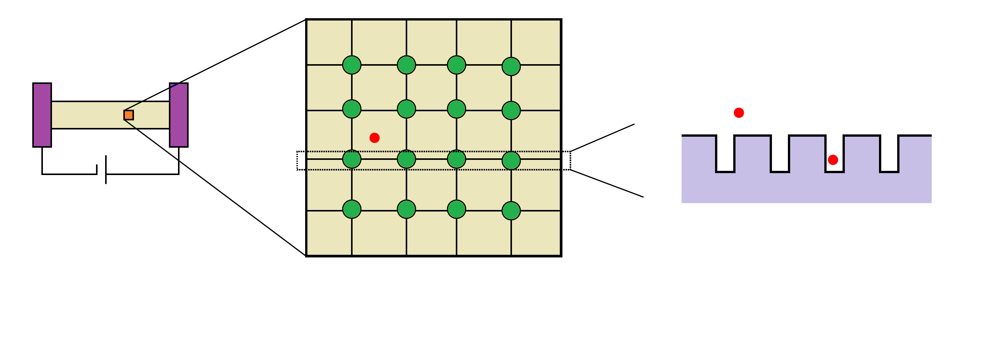
Why Quantum Mechanics?...
Device Level
Material Level/Periodic Structure
Quantum Mechanical Model
Single crystal←→ Polycrystalline ←→ Amorphous materials

Slide 8
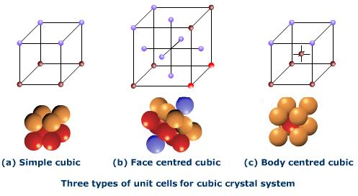
What is “periodic potential” ?
Quantum Mechanical Model

Slide 9
The Schrodinger Equation
Erwin Schrodinger develops a mathematical formalism that incorporates the wave nature of matter:
The Hamiltonian:
The Wavefunction:
Kinetic Energy
E = energy

Slide 10
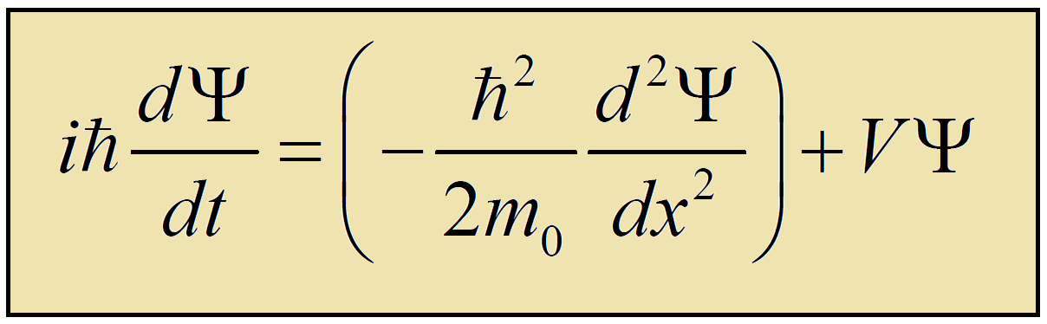
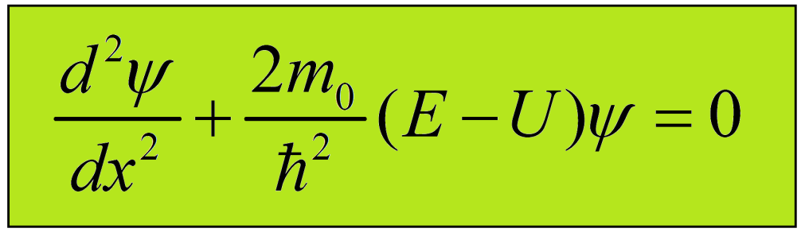
The Schrodinger Equation
The time dependent Schrödinger Equation
The time independent Schrödinger Equation

Slide 11
Potentials and Quantization
Let us discuss when the particle is free (i.e. under no potential constrains) and under potential constrains
But why should we bother about it?

Slide 12
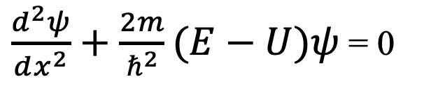
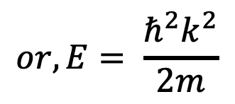
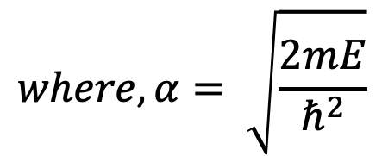
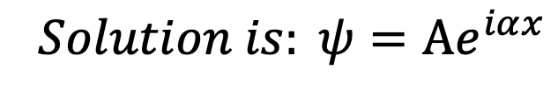
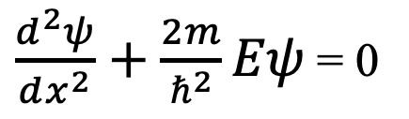
Energy Continuum of A Free Particle
Consider a particle free to move in one dimension:
Case: ‘Free’ Particle
Potential E = 0
The Schrodinger Equation becomes:
0
$\frac{d^{2}ψ}{dx^{2}}+\frac{2m}{ℏ^{2}}(E−U)ψ$ = 0
$\frac{d^{2}ψ}{dx^{2}}+\frac{2m}{ℏ^{2}}Eψ$ = 0
$$where,α= \sqrt{\frac{2mE}{ℏ^{2}}}$$
$$or, E= \frac{ℏ^{2}k^{2}}{2m}$$
$$Solution is: ψ=Ae^{iαx}$$
Energy ranges from 0 to infinity….not quantized, particle can have any arbitrary velocity

Slide 13
Energy States of A Bound Particle
What if the position of the particle is constrained by a potential?
Classical Case: “Particle in a Box”
Potential E
E = 0 for 0 ≤ x ≤ L
E = ∞ for all other x
The possible position of particle is limited to the dimensions of the box, 0 to L

Slide 14
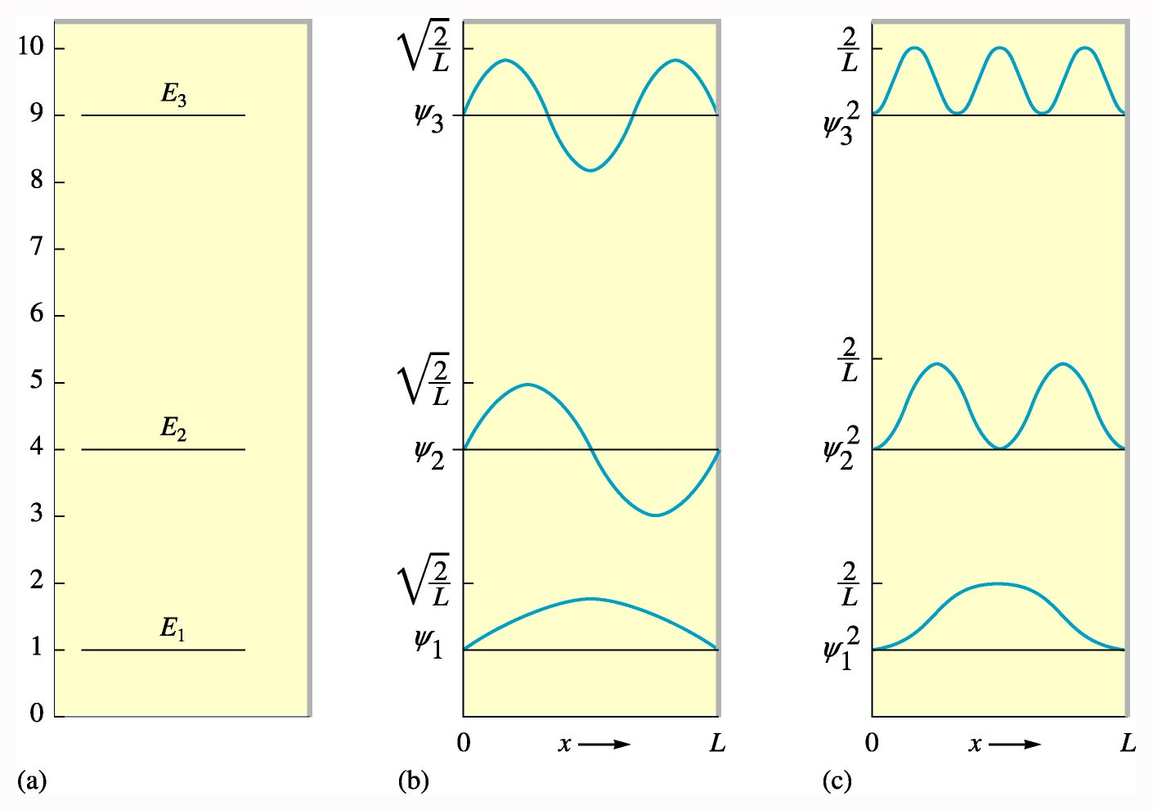
Energy States of A Bound Particle
How does the energy look like?
n = 1, 2, …
Energy is quantized
E
ψ
ψ∗ψ

Slide 15
Classroom Quiz
Sketch ψψ*=72 for an electron in a one dimensional potential well. What conclusion it can be drawn?

Slide 16
End of the Class # 2

